Slide 1
CHAPTER 3
LOGIC
BOOLEANS

Slide 2


QUIZ
Which number is valid for this condition ?
5 MIN
CLASS
( background==
and value <5 )
or border ==
5
7
4
9
2
6

Slide 3
( background==
and value <5 )
or border ==
5
7
4
9
2
6

Slide 4
QUIZ
Which number is valid for this condition ?
5 MIN
CLASS
( background==
or value < 6 )
and border ==
5
7
4
9
2
6

Slide 5
( background==
or value < 6 )
and border ==
5
7
4
9
2
6

Slide 6

GAME
You are allowed to enter at PNC if :
5 MIN
CLASS
You have an helmet OR ( you are a teacher AND you are superman)
If you are superman, can you enter PNC ?
If you are superman with helmet, can you enter PNC ?
If you are a teacher, can you enter PNC ?

Slide 7

GAME
I go to the beach if :
- Temperature is more than 30°C and I have a day off
5 MIN
CLASS
- But I also go if it’s Khmer New Year
Let’s define the conditions:
A = Temperature is more than 30°C
B = I have a day off
C = it’s Khmer New Year
Write the boolean expression that define if I go to the beach or not :

Slide 8
We want to demonstrate that:
EXPLAIN
5 MIN
CLASS
A or False = A
1- Calculate the TRUTH table
2- Check the columns are identical
A | A or False
False | False
True | True
A | A or False
False | False
True | True
So A = A or False

Slide 9

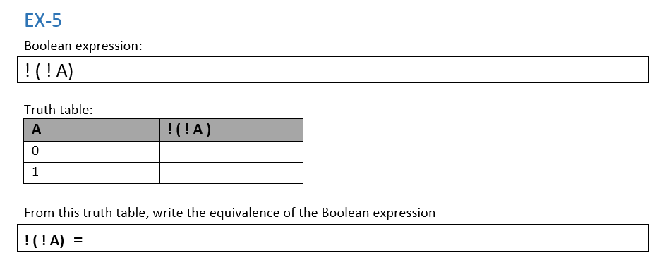
Perform exercises 1 to 6
ACTIVITY
10 MIN
INDIV

